Slide 1


Slide 2
Managing a business can be stressful, chaotic and time consuming.
“That is what inspired a team of developers at Prys to address the needs of small business to maintain, grow and expand through better stock management, fluent sales and quotation processes, effective invoicing and payments tracking”

Slide 3

2014
Started as Prys Comparison a small business marketing portal
2016
Renamed to Bits N Bytes ERP offering Odoo implementation to small businesses
2018
Launched Version 1 of ERP with special focus on Point of Sale for retail and hospitality sectors.
2020
2021
Launched Version 2 with a new pricing structure and support system, that saw us being able to serve users better.
Renamed to Prys Accounting. The move that helped identify the software, help shape the market.
2021
Launched Version 3 and 4. Introduced 2 Packages and Cloud software solutions to accommodate more businesses.
Prys Accounting is managed from East London, South Africa with customers across South Africa and a fast growing clientele in Namibia, Zimbabwe, Botswana and Swaziland.

Slide 4
Notable Features

Slide 5
Quotations and Invoicing
Send and print out professional Quotations and Invoices.
One of our strongest features is the easy to use quotations and invoicing system.

Slide 6
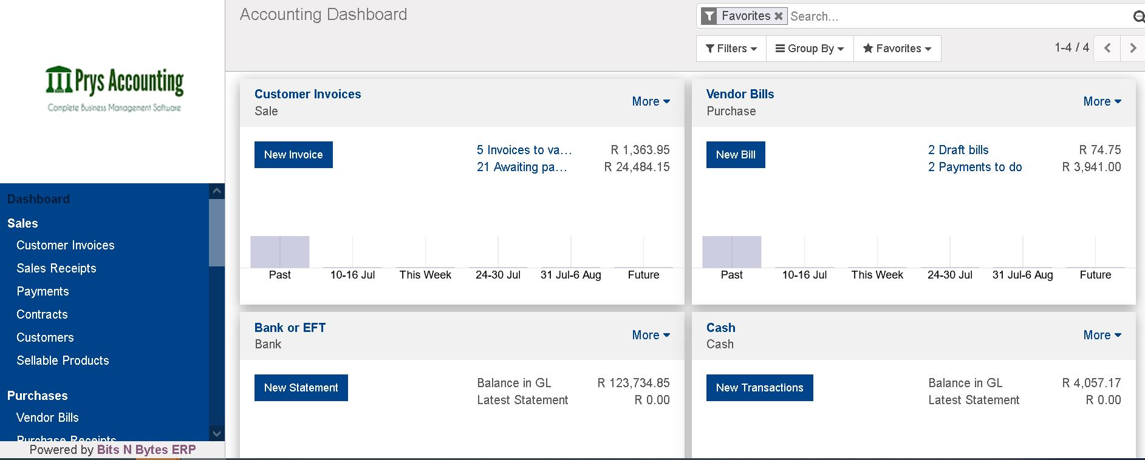
Accounting and Bookkeeping
It would be a comfort to mention that we made Prys easy to use for someone with little or NO bookkeeping background. Its made for you.
Connect an accountant
Easily print out tax and financial statements
Creditors and Debtor Statements
Customer Age
Bank Reconciliation
Graphical and interactive reports
Export reports to excel*

Slide 7
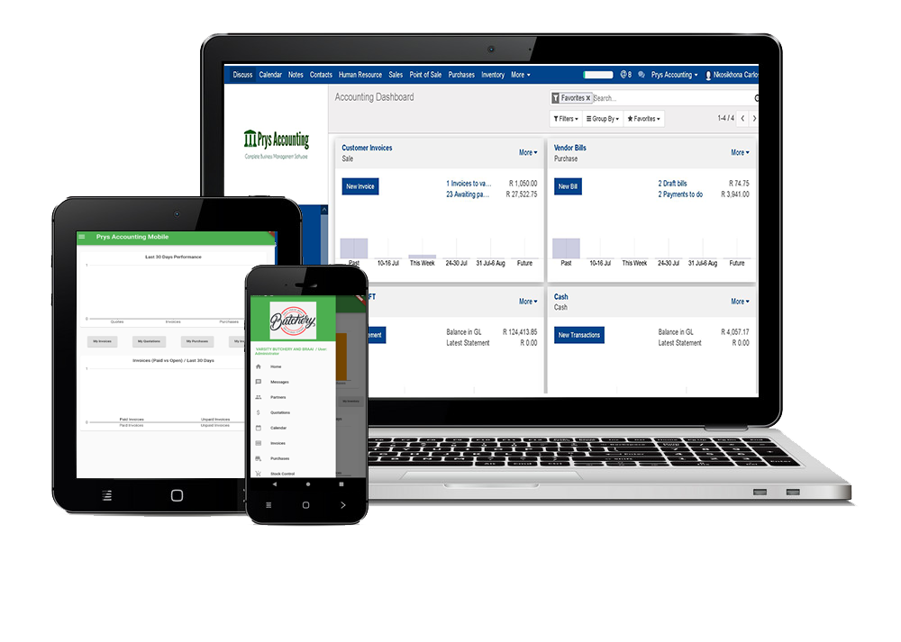


The beauty of Cloud Accounting.
Send quotations, estimates, invoices and payment reminders on the go.
Works on Desktop, PC, Mac, Tablet and Mobile

Slide 8







Fluent connection between users, assets and stock. No user limits.
Send Quotations and Invoices
Work from anywhere or device
Manage Payroll and work shifts
Stock Control, Multi warehouse / location support
Link an accountant
Request Leave and Salary Advance

Slide 9

Manage Stock, Locations and warehouses
From managing a few bottles to managing multiple warehouses with branches.
We got you!

Slide 10
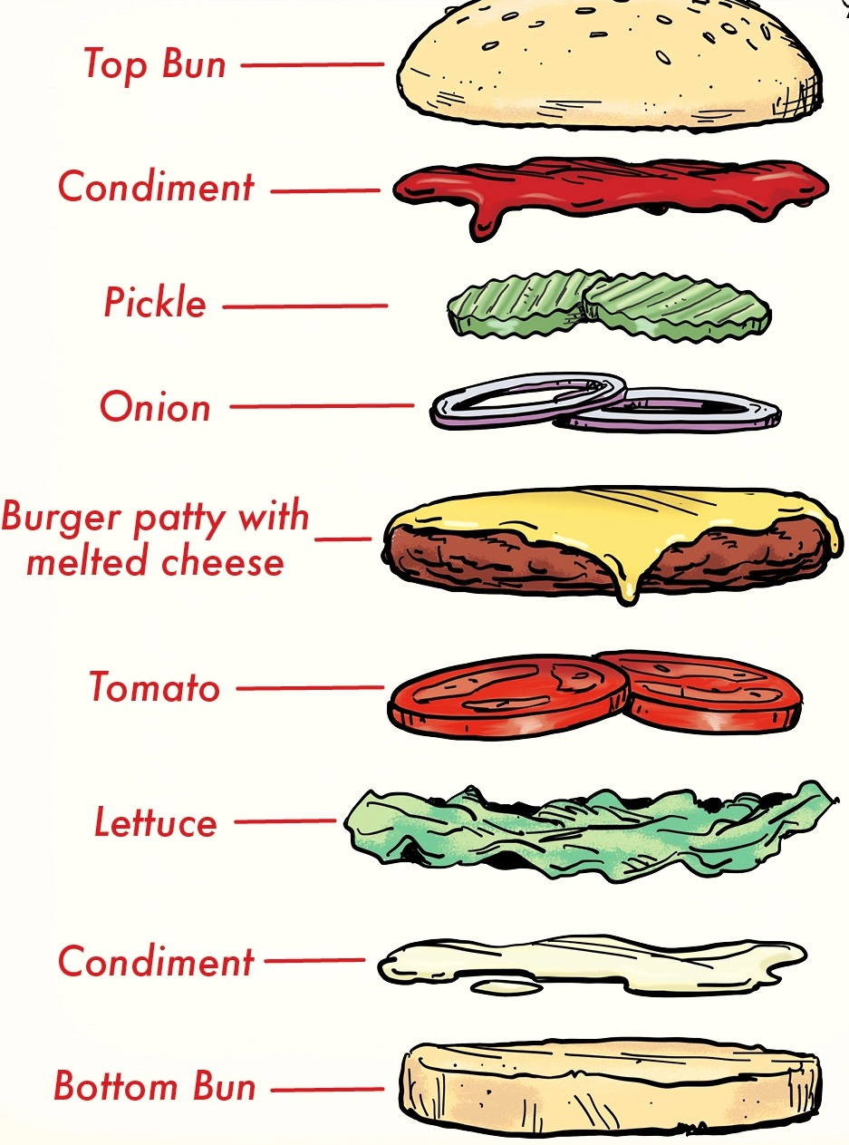
Account for every nail and every tomato with advanced Bill of Material.
Works for Manufacturing Businesses

Slide 11
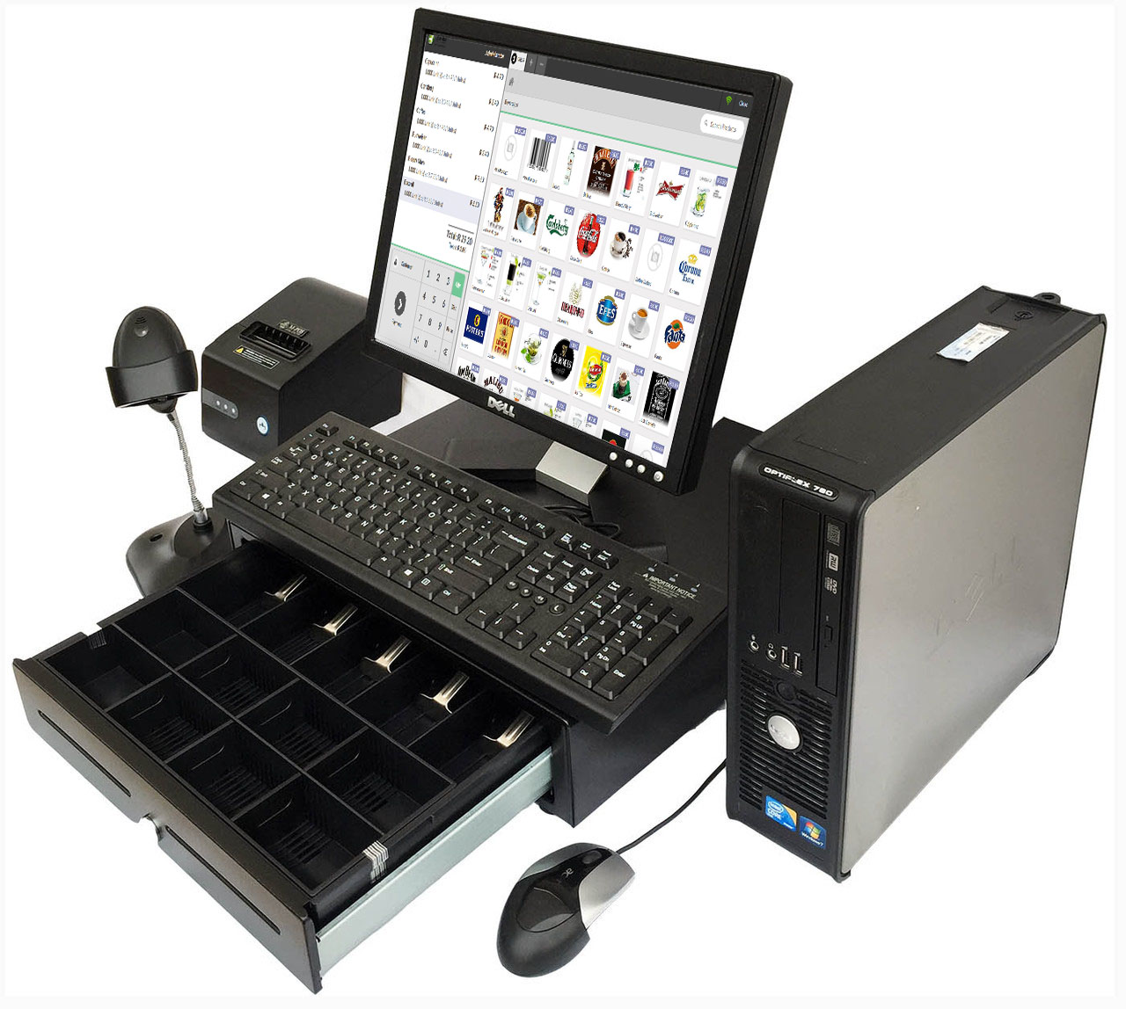
Easy to use Point of Sale. Compatible with a wide range of Devices.

Slide 12
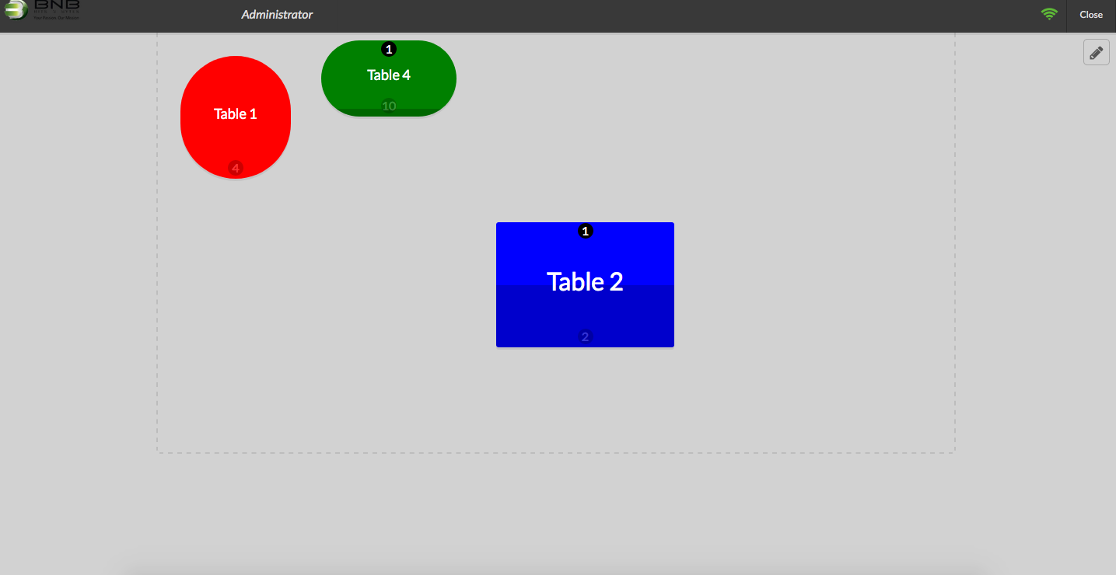
Floor and Table Management for Restaurants

Slide 13
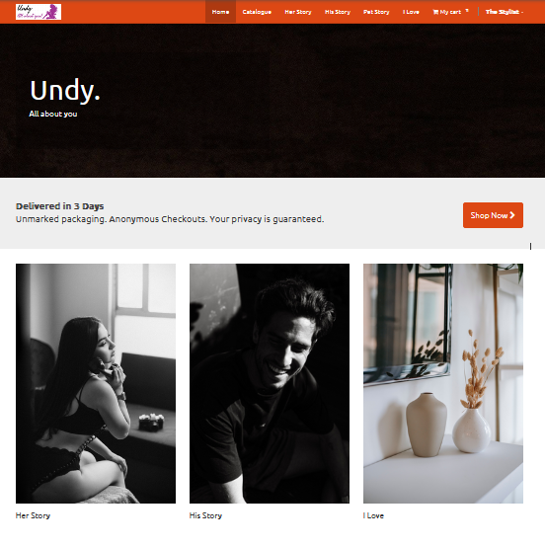
Website Builder.
Online Store builder.
Sell online Instantly.
Secure payments.
Easy Integrations.
Linked to Accounting.
Connects to Socials.

Slide 14
…and other features like
Contract and Renewal/Subscription billing
Stock and warehouse Control
Hotel room reservation system
Multi User management
Cashflow management
Task Management
Purchases and GRV control
Mass Mailing list management
Product tracking and serial number Tracking
Repairs module for managing workshops and repair centres
… the list is sort of endless.

Slide 15
One on One Support
Training is free for 1 hour sessions with 4 or less guests and if you need more time we have a training package at R1299 for 3 hours with 6 or less guests.
We boast of 24 hour availability on whatsapp and tawk.to channels.
One on One support means you are assigned a contact and support agent to help you with Prys Accounting and implement your system.
We build relationships with our customers, we are your friend in this business.
Our onboarding process is quick, painless and friendly. We could start right away, what are we waiting for?

Slide 16

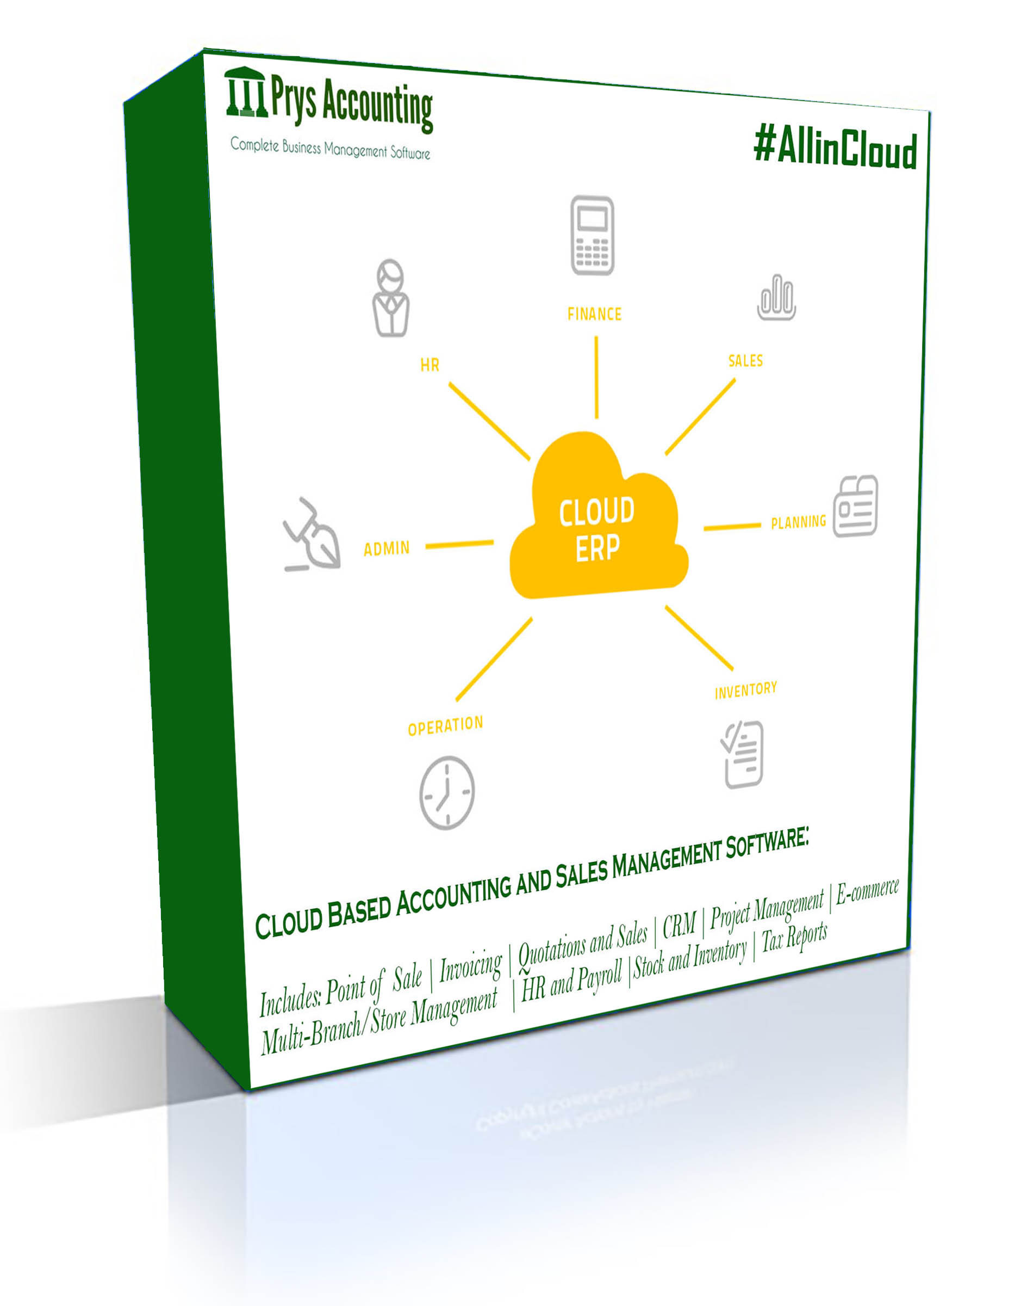
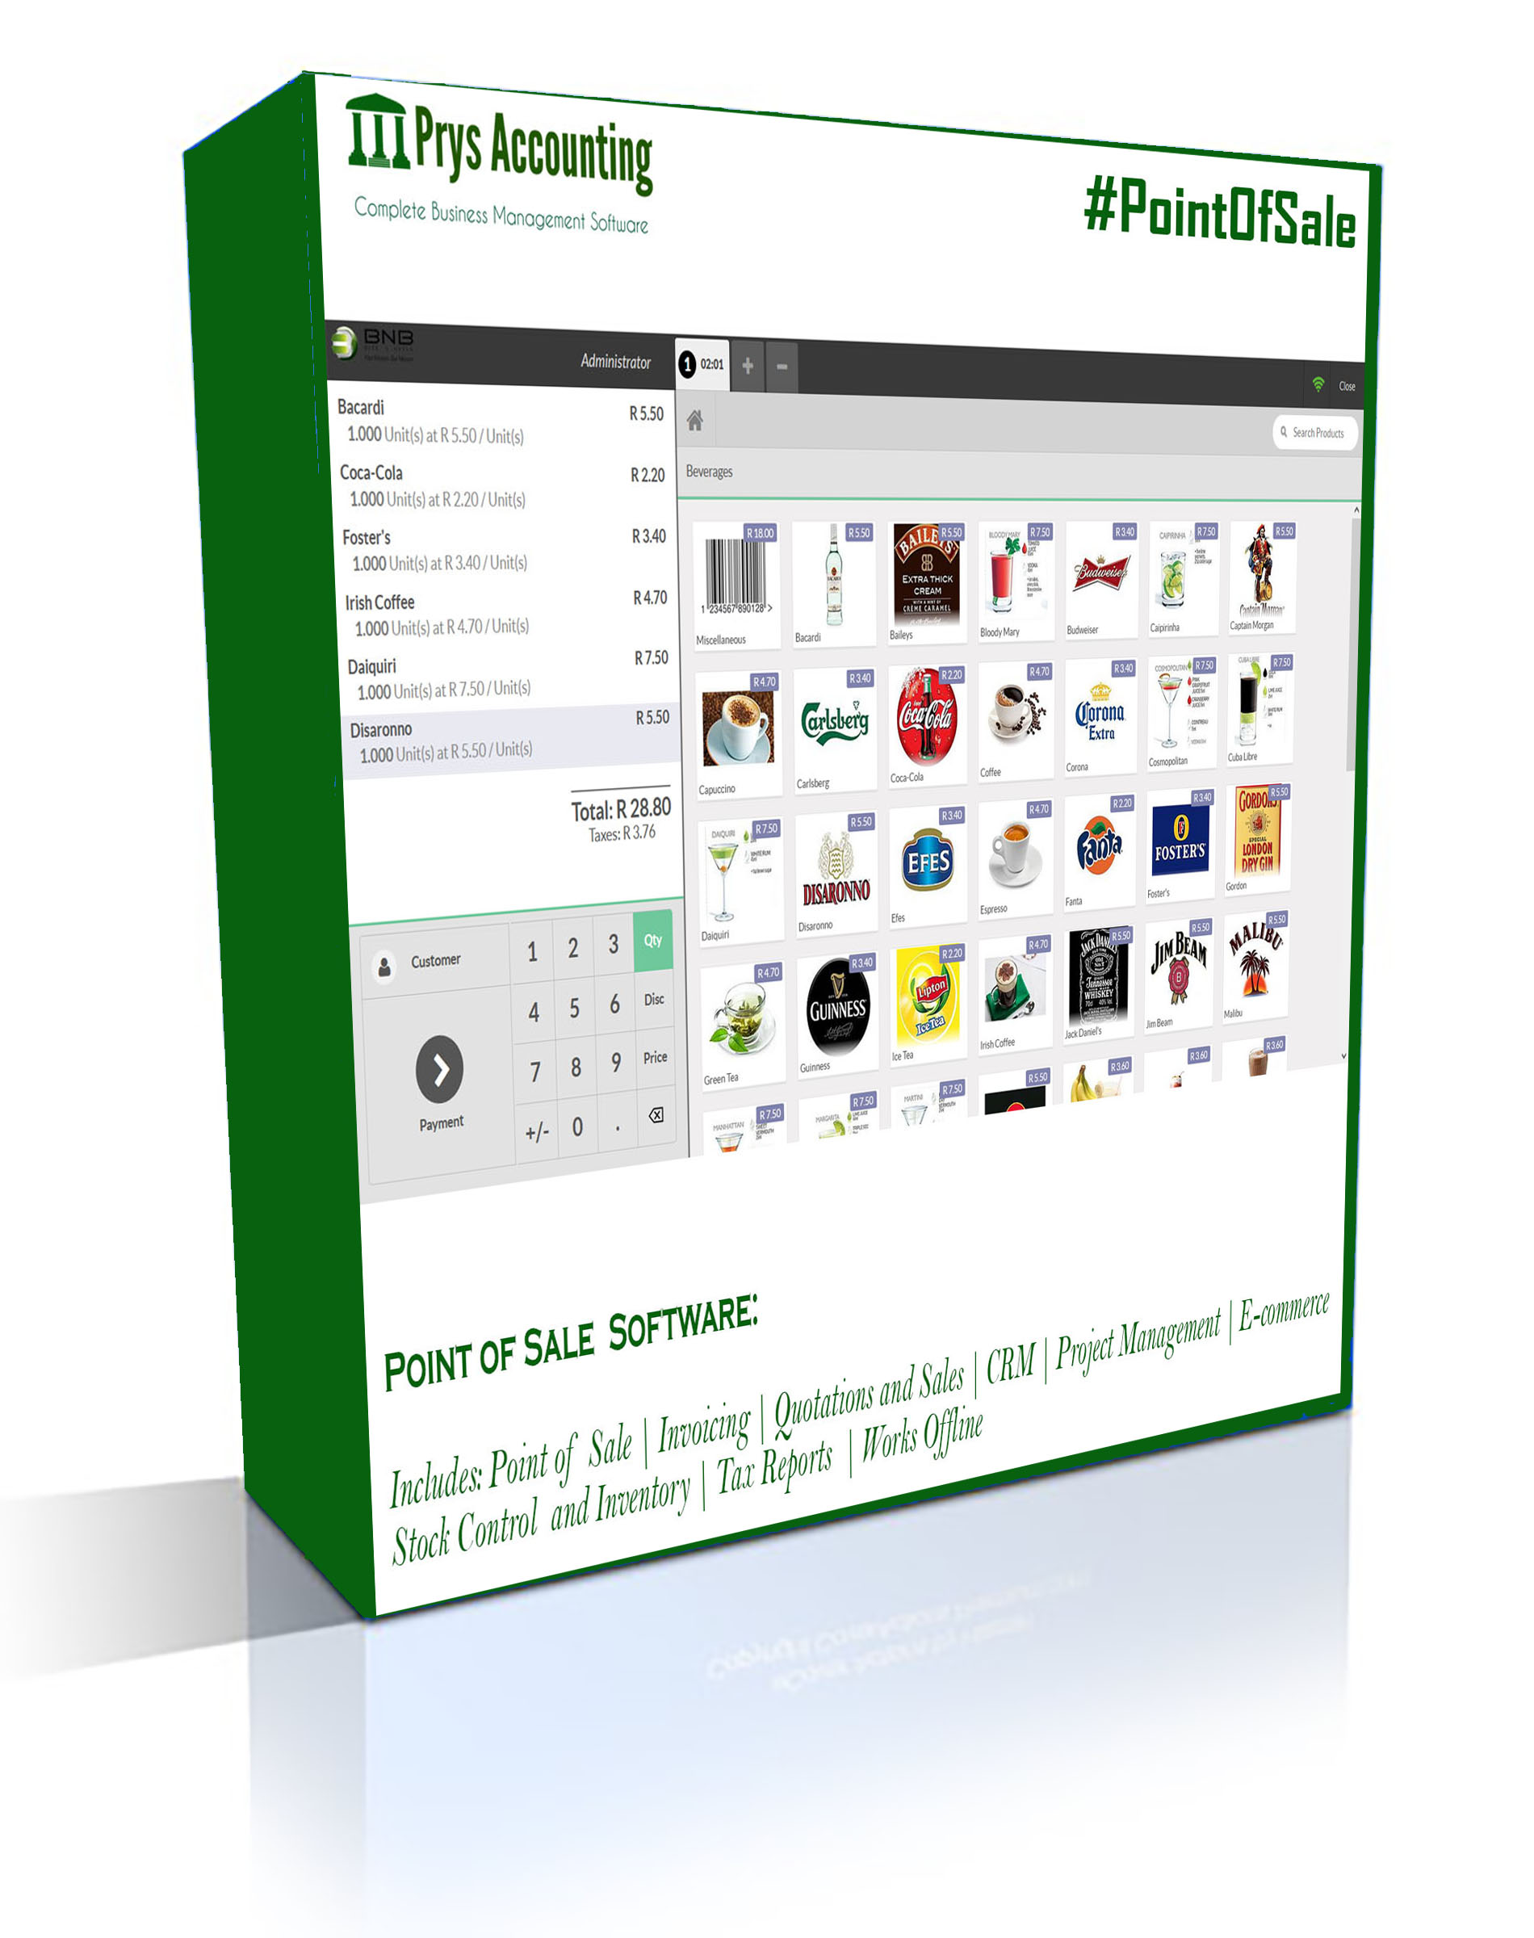
Our Packages
#CloudLite for R179pm
Designed for professional Services business like tenderpreneurs, plumbers, lawyers, electricians.
Smart Invoicing and Payment tracking
Easy Accounting, Tax and Profit Reports
Available - Mobile app, Cloud based, Desktop and works with teams
Up to 10 Users
#PointofSale for R249pm
For a fast paced retail store, restaurant, tavern or bar, liquor outlet, etc.
Smart stock and Inventory control
Table and Floor management
Accounting backend
Works Offline
Up to 10 Tills and one Server or Store
#AllinCloud for R399pm
Designed for a business that believes in growth and evolving operation
Smart Invoicing and Payment tracking
Website and Online Store builder.
Available - Mobile app, Cloud based, Desktop and works with teams
HR and Payroll
Point of Sale
Multi Branch / Multi Store Support

Slide 17
The Technology
Core App:
Backend Languages: Python, Django, Odoo 10 as a framework
Frontend languages: Java, JS, Json, Css, HTML, Bootstrap, Jquery, Kotlin
Database:
Postgresql 9.5
Desktop App:
Exe installer installs Prys Accounting as a service that runs a windows python server with default port :8069. The installer also extracts and installs Postgresql.
Client:
The software relies on a web browser to deliver client features, our preferred browser is Firefox.

Slide 18

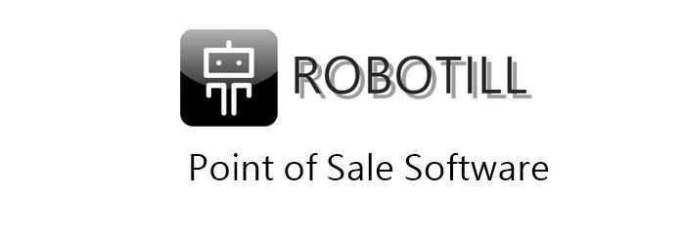









How we compete
Affordable
Limited Features
Most Features (ERP)
Expensive

Slide 19
www.prys.co.za

